Slide 1

European Soccer Analysis
Team Number: 25
Team Members:
Akshita Barot (002704943)
Gauri Patole (002700996)

Slide 2

Contents:
Introduction
Data Wrangling
Exploratory Data Analysis
Feature Engineering
Data Modeling
Model Evaluation
Conclusion

Slide 3



Background, Motivation and Goal

Slide 4

Background:
The UEFA (Union of European Football Associations) Champions League often known as European Soccer League, is a continental football competition that attracts the best soccer teams from across Europe.
Motivation:
The European soccer dataset analysis provides valuable information on matches, teams, and players from several European leagues, allowing researchers and enthusiasts to gain deeper insights into the game.
Through data analysis, teams and analysts can use the European soccer dataset to make strategic decisions and gain a competitive advantage in the sport.
Goal:
We want to create a football prediction model, this model will determine the outcome of match (win, lose, draw) and compare it with the bookies model.

Slide 5


About the Dataset:
The data was collected for Eleven European Leagues and is stored in the form of ‘sqlite’.
Dataset consists information of 25000+ matches and 10000+ players from the top football leagues of 11 European nations and covers from seasons 2008 to 2016.
Tables | Rows | Columns
Country | 11 | 2
League | 11 | 3
Match | 25979 | 115
Players | 11060 | 7
Player_Attributes | 183978 | 42
Team | 299 | 5
Team_Attribute | 1458 | 25

Slide 6


Exploring the dataset to check for missing values, duplicate values, and data types.
Dropping unwanted and Null columns
Creating a new column ‘winner’ in Match table.
Changing datatype of Date column from ‘String’ to ‘DateTime’.

Slide 7
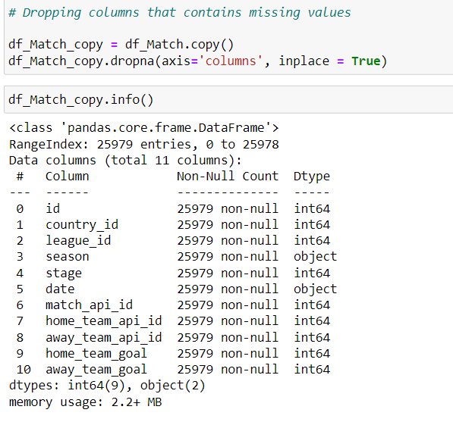
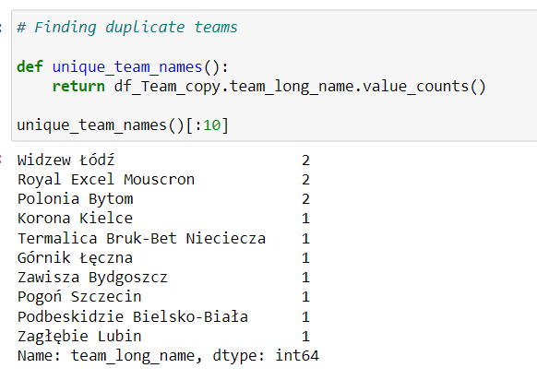
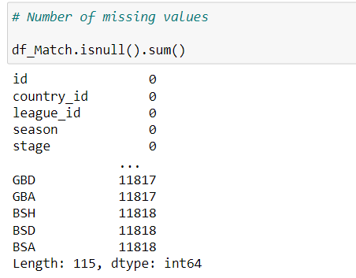
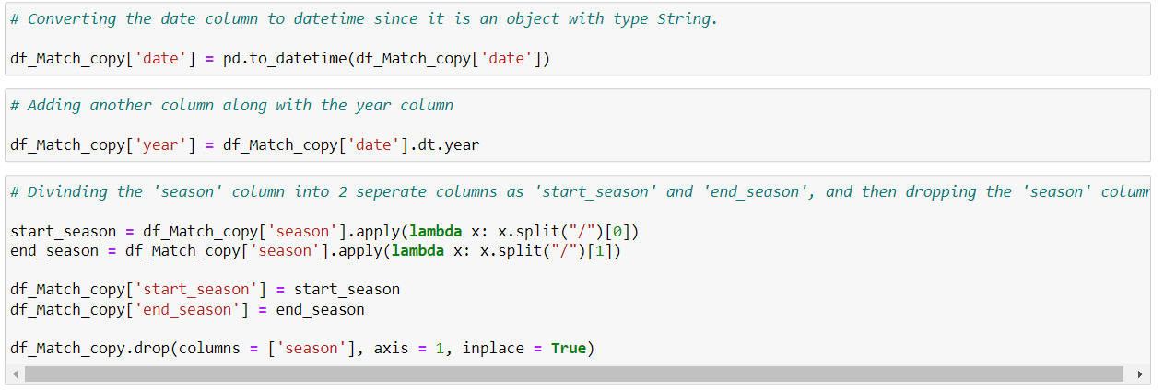
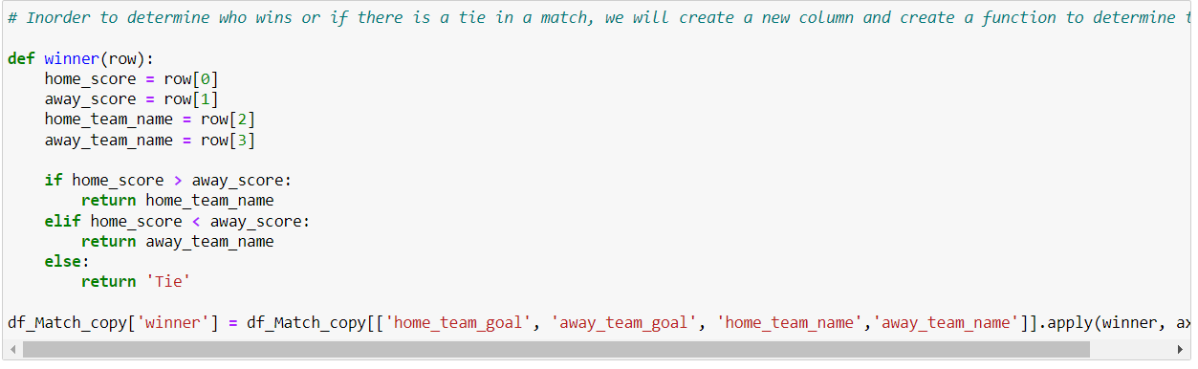

Slide 8



Slide 9
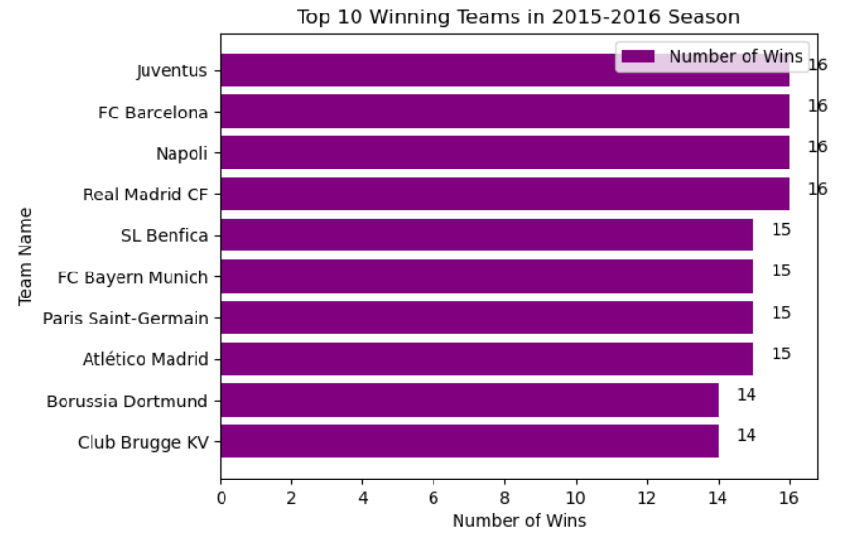

Q1. Which top 10 teams had the most victories at home in 2015/2016 Season?
Extracted the matches that occurred during the period of 2015 to 2016.
We identified the top 10 teams that have the maximum number of wins and found that there were four teams with 16 wins in 2015/2016 season.

Slide 10
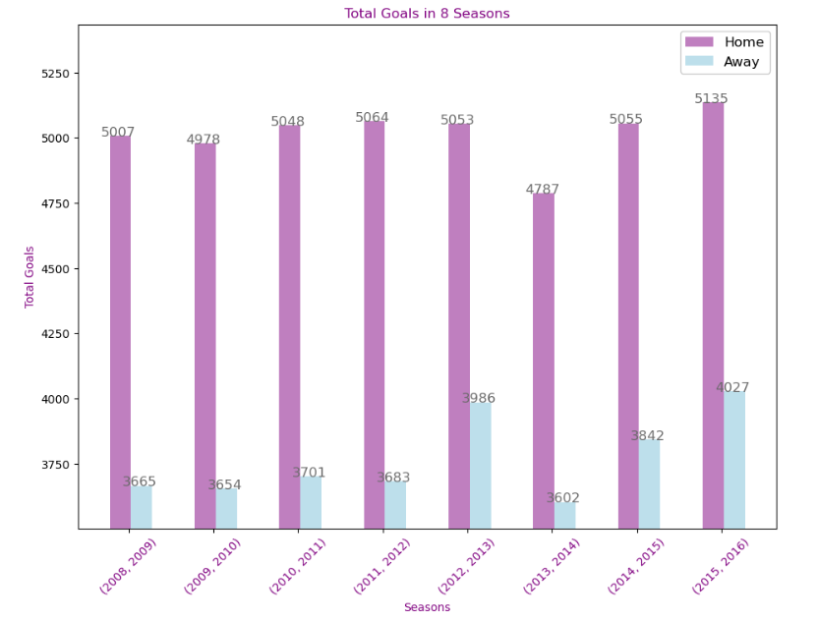

Q2. Which season had the most home and/or away goals over the seasons?
Comparing the home and away goals for each season, and consistently showing that home teams score more goals than away teams.
Notably, the season 2015-2016 had the highest total number of goals scored.

Slide 11
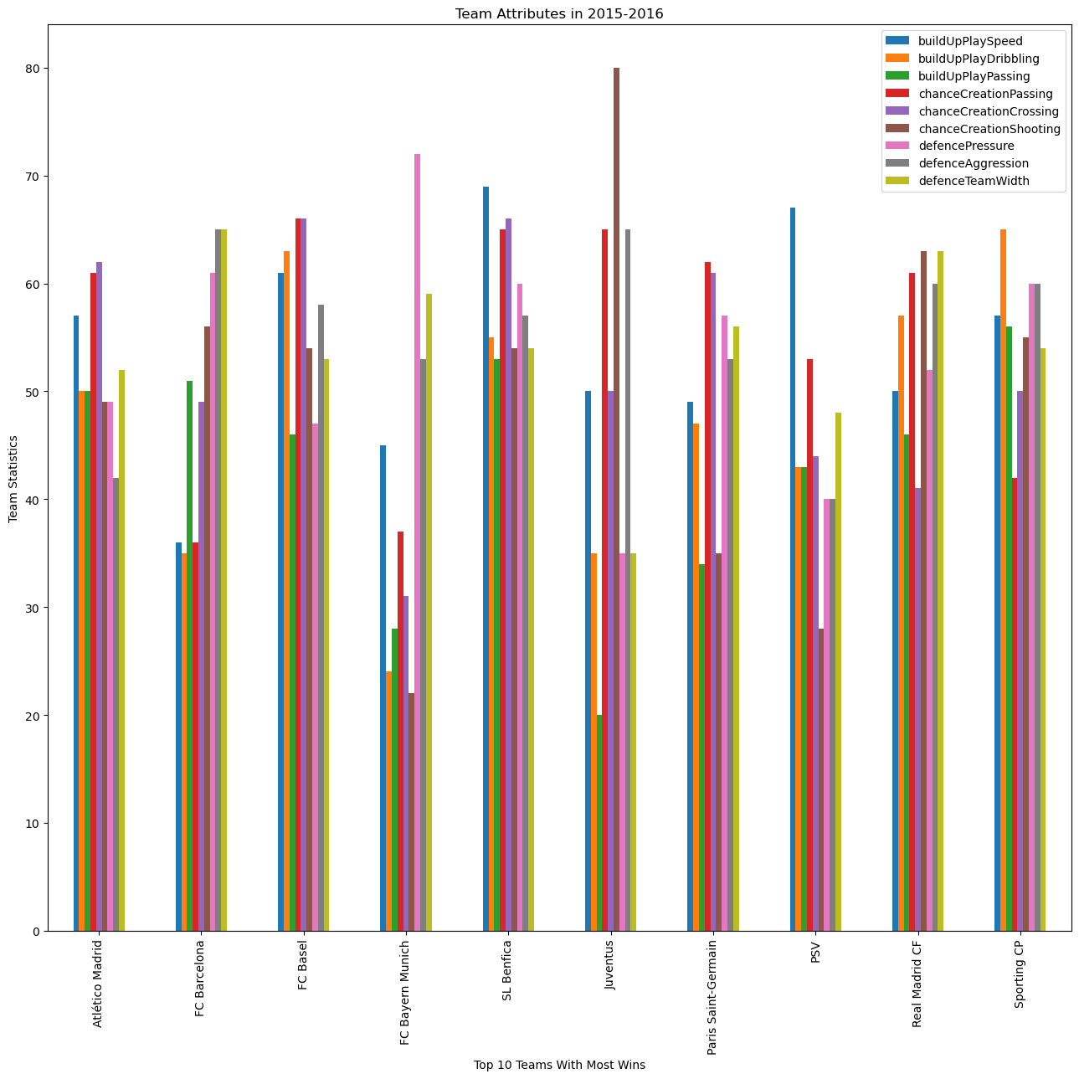
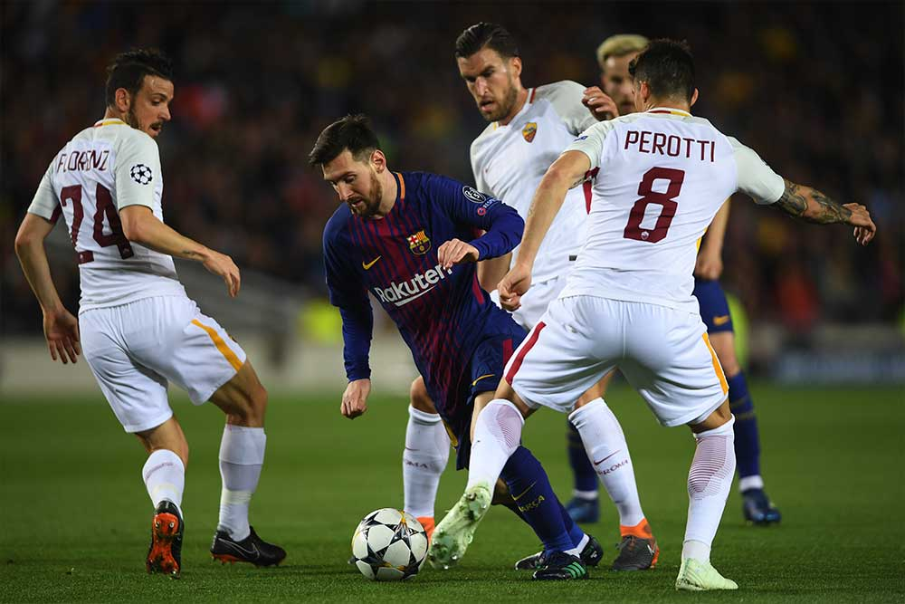
Q3. What Team Attributes leads to a Team's Victory?
The chart provides attributes of the winning teams. These charts display 9 distinct characteristics for the top 10 winners during the 2015-2016 season.

Slide 12


Slide 13
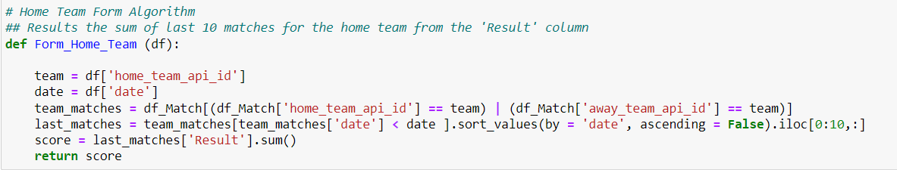
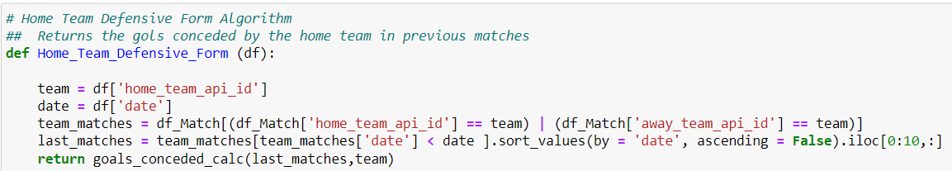
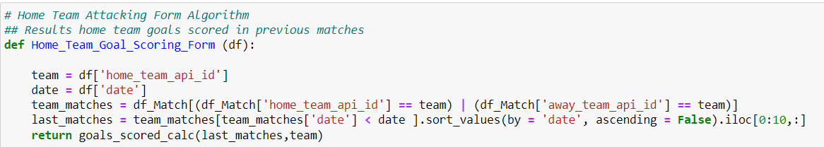
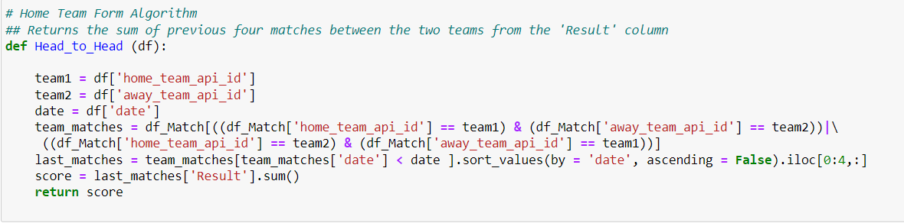
After completing the data cleaning, and performing Exploratory Data Analysis, the next process of selecting the features is important.
We created feature functions for ‘From_Home_Team, ‘Home_Team_form’ and ‘Away_Team_form, ‘Attacking Form’, ‘Defensive Form’, ‘Head to Head’ which were essential for our model.

Slide 14
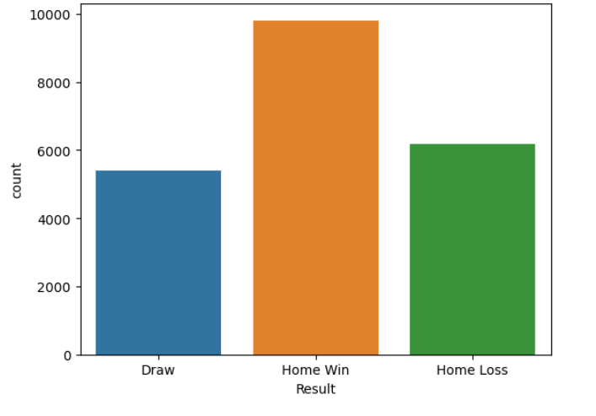
Visualizing our Target Variable: Match Result
We have used ‘countplot’ on the ‘Result’ column which represents the outcomes such as ‘Home Win’, ‘Draw’, and ‘Home Loss’ of soccer matches.
Since there are different types of player positions in a team, we started with exploring the ‘Player_Attributes’ all the players as per their playing positions.

Slide 15
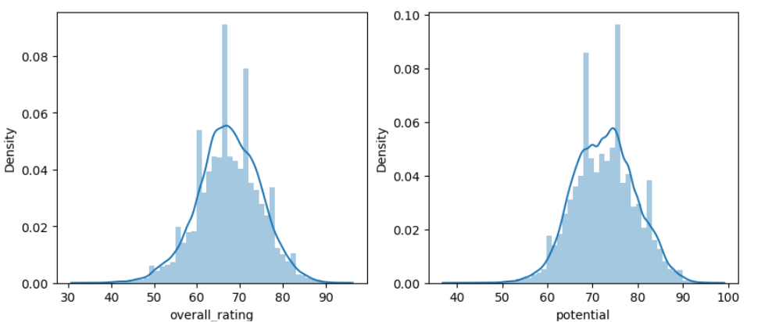
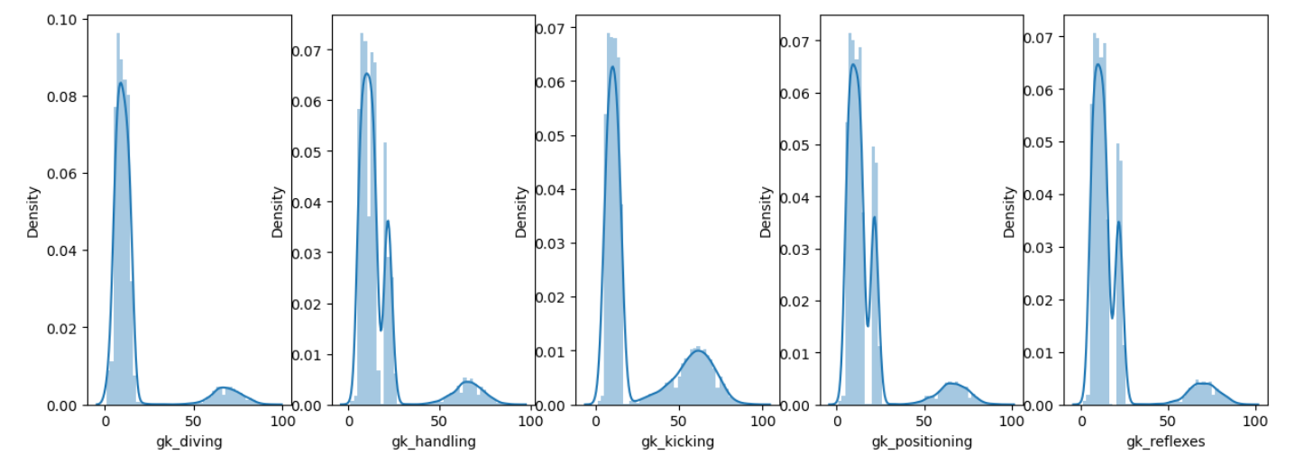
Player Attributes Exploration:
Goalkeeper Attributes:

Slide 16
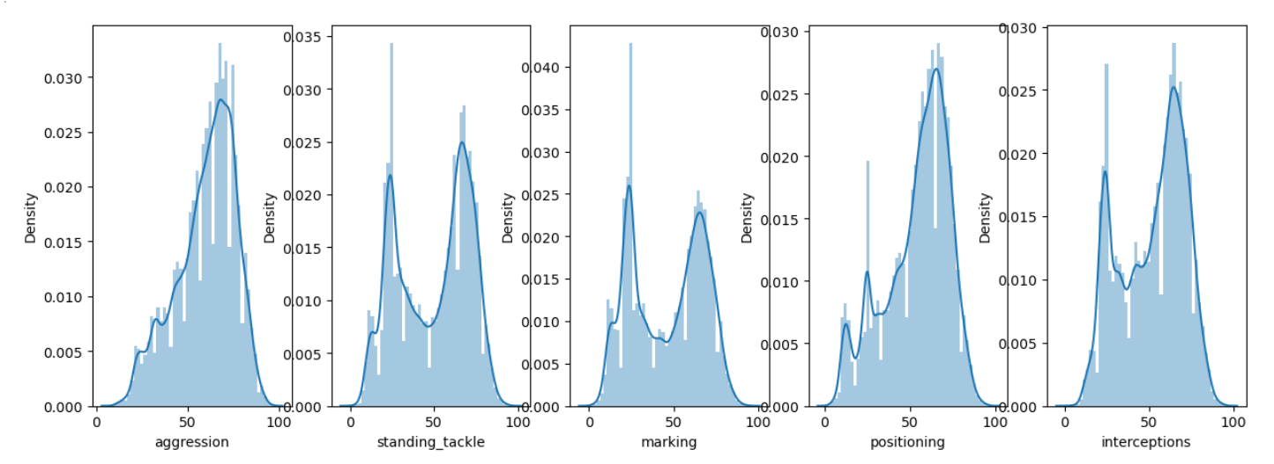
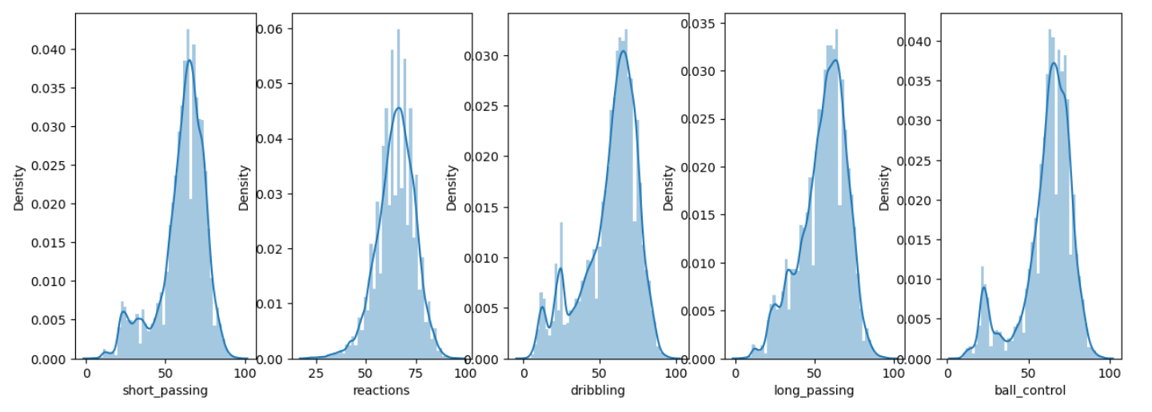
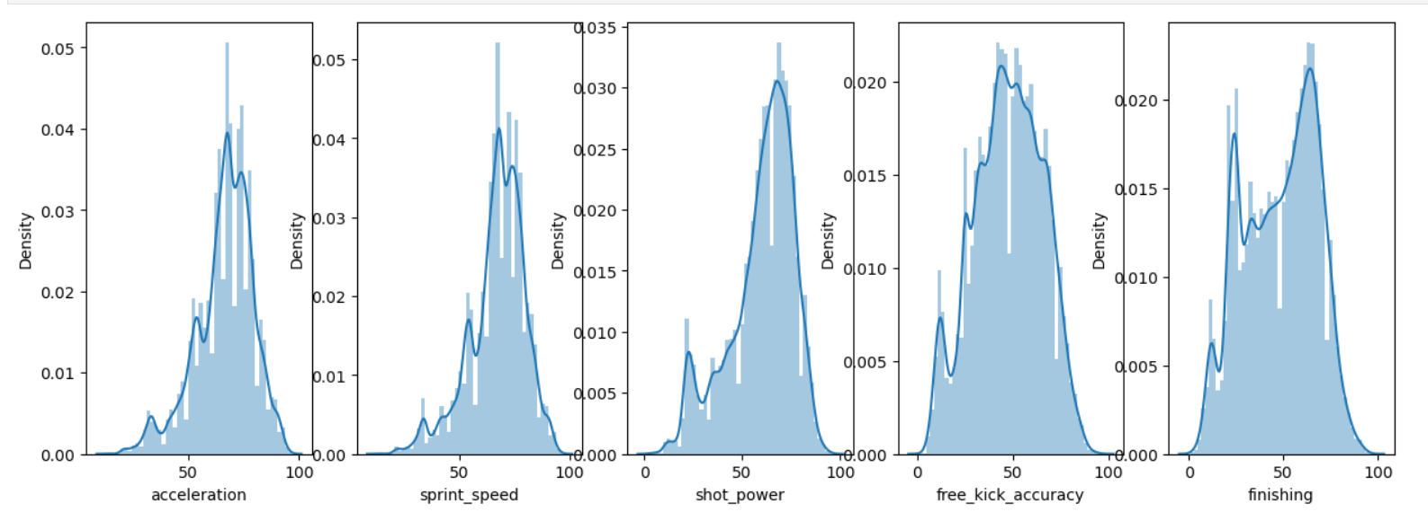
Defender Attributes:
Midfielder Attributes:
Striker Attributes:

Slide 17


Slide 18
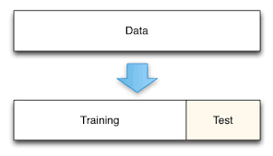
Splitting Training and Test Data
Training data - Matches played between 2008 and 2014.
Test data - Matches played between 2015 and 2016.
We started off with dropping all the null values from our Training and Test data, and dropping the columns which were not required, and then feeding it to our training and testing set.

Slide 19
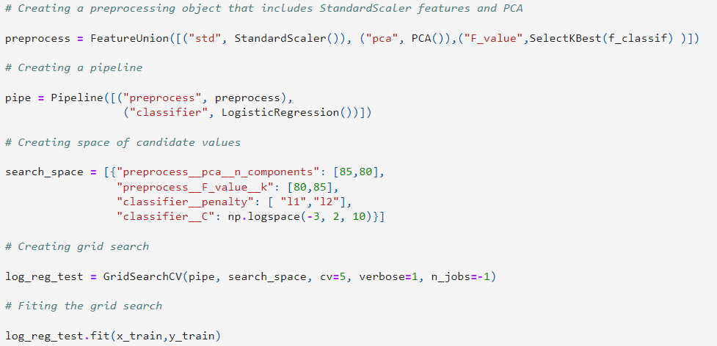
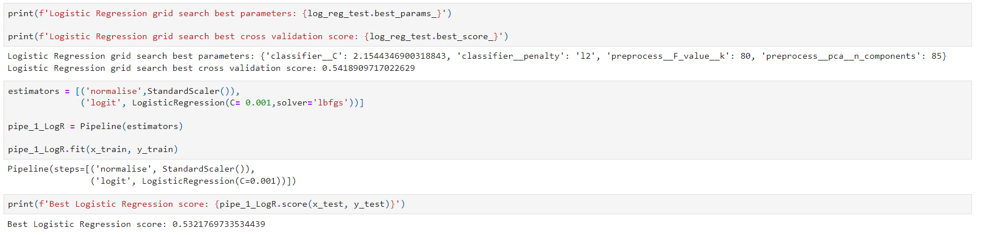
Logistic Regression
Logistics Regression model predicts a dependent data variable by analyzing the relationship between one or more existing independent variables.
Created preprocessing objects that included the StandardScaler features and PCA, created a pipeline and used GridSearchCV.
Logistic Regression Score : 0.53217

Slide 20
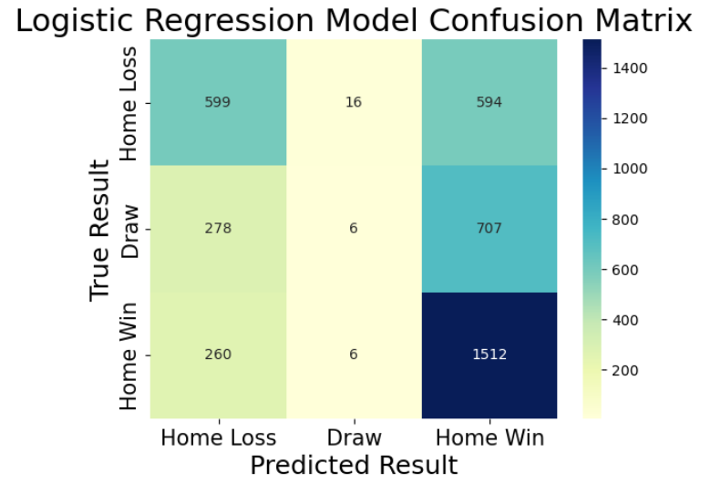
Logistic Regression
We plotted the Logistic Regression Confusion Matrix using the Seaborn's heatmap function to visualize the performance of a logistic regression model with three classes: "Home Loss", "Draw", and "Home Win".
We can infer that most of the Home Win and Home Loss were predicted correctly, while a lot of Draws were not classified correctly.

Slide 21
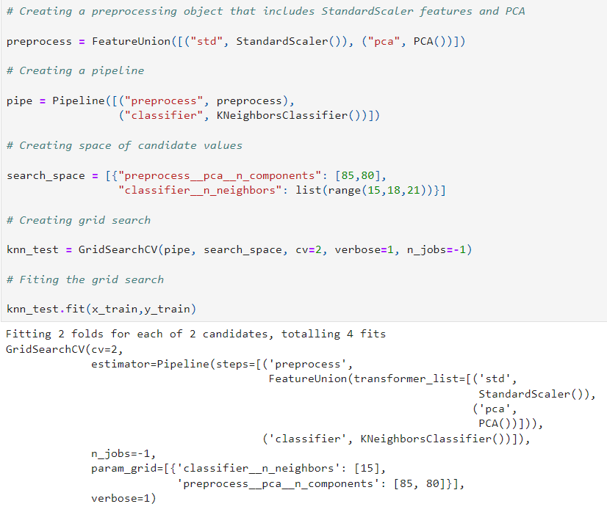
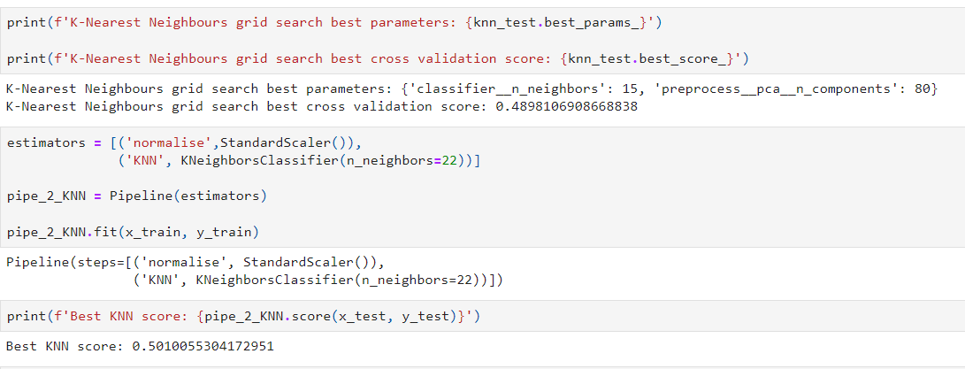
K-Nearest Neighbors
The algorithm works by calculating the distances between the new observation and all the observations in the training set. KNN is a non-parametric algorithm, meaning it does not make any assumptions about the underlying distribution of the data.
Created preprocessing objects that included the StandardScaler features and PCA, created a pipeline and used GridSearchCV.
KNN Score : 0.50100

Slide 22
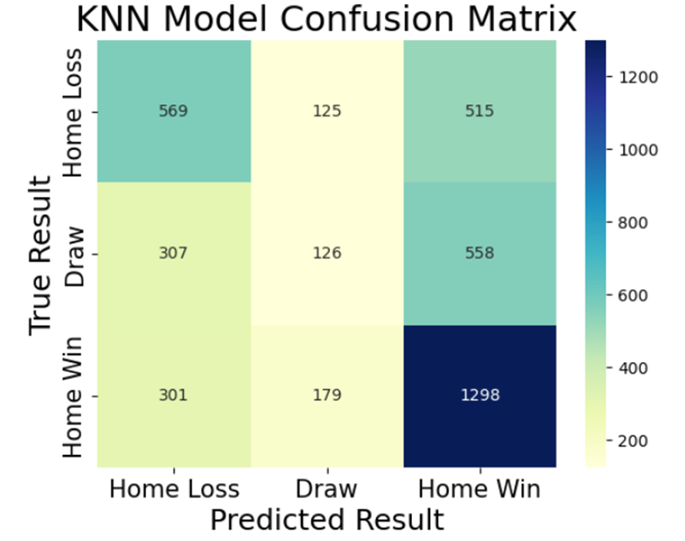
K-Nearest Neighbors
We plotted the K-Nearest Neighbors Confusion Matrix using the Seaborn's heatmap function to visualize the performance of KNN model with three classes: "Home Loss", "Draw", and "Home Win".
In comparison to the Logistic Regression model, while most of the Home Win and Home Loss were predicted they were not better than the Logistic Regression model, but the prediction of Draws was better.

Slide 23
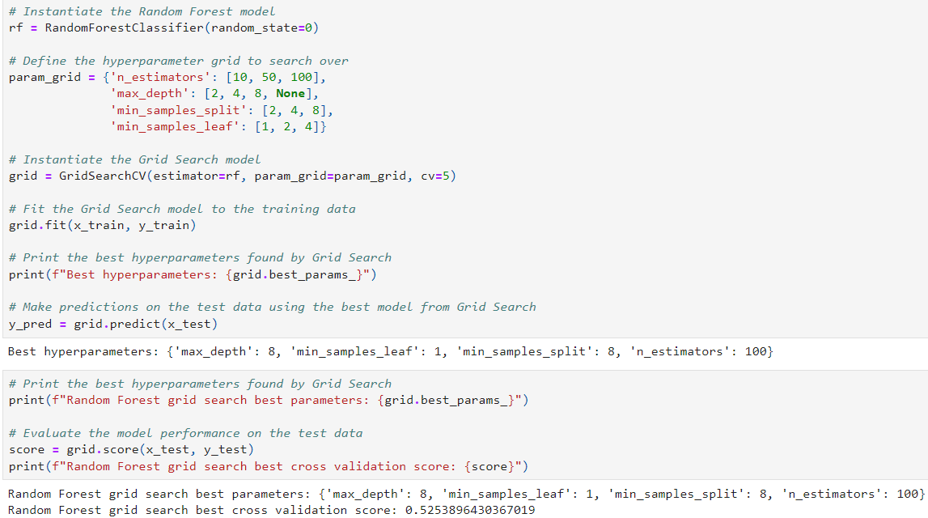
Random Forest
Random Forest is an extension of decision trees, the"random" part of the name comes from the fact that each tree in the forest is constructed using a random subset of the training data and a random subset of the input features.
The Random Forest Classifier model is instantiated with a random state of 0, defined the hyperparameters and used GridSearchCV.
Random Forest Score : 0.52538

Slide 24
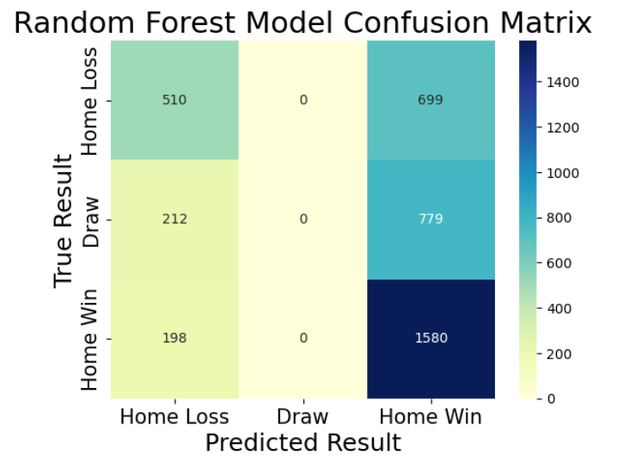
Random Forest
We plotted the Random Forest Confusion Matrix using the Seaborn's heatmap function to visualize the performance of the Random Forest model with three classes: "Home Loss", "Draw", and "Home Win".
In comparison to two previous models, while most of the Home Win were predicted correctly and Home Loss were approximately same as the Logistic Regression model, the Draws were either predicted as Home Loss or Home Win unlike the other two models.

Slide 25
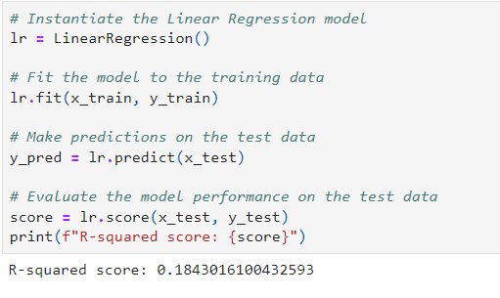
Linear Regression
Linear regression is a statistical method used to model the relationship between a dependent variable (also known as the response variable or target variable) and one or more independent variables (also known as the predictor variables or features).
R-squared score – 0.18, which suggests that the linear regression model explains only a small portion of the variation in the dependent variable.

Slide 26
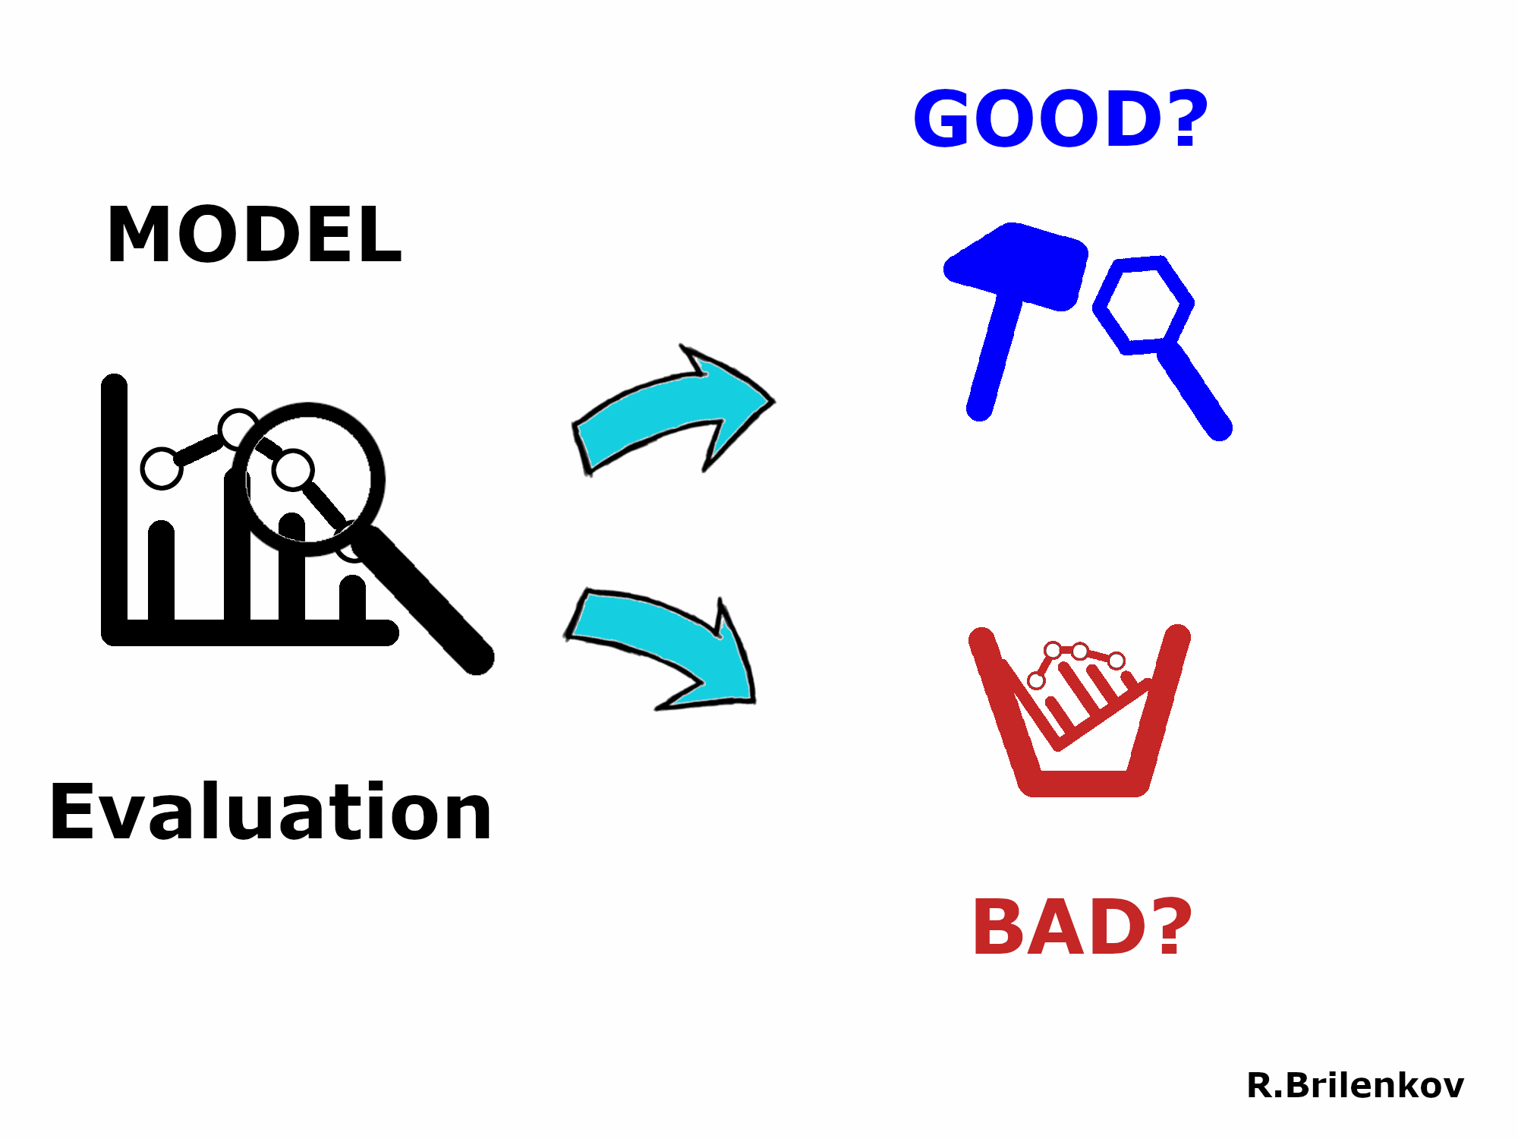

Slide 27
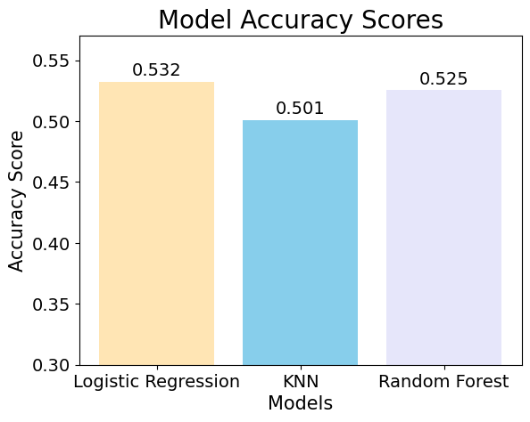
Model Evaluation
Best Logistic regression score : 0.532
Best KNN Score : 0.501
Best Random Forest Score: 0.525

Slide 28
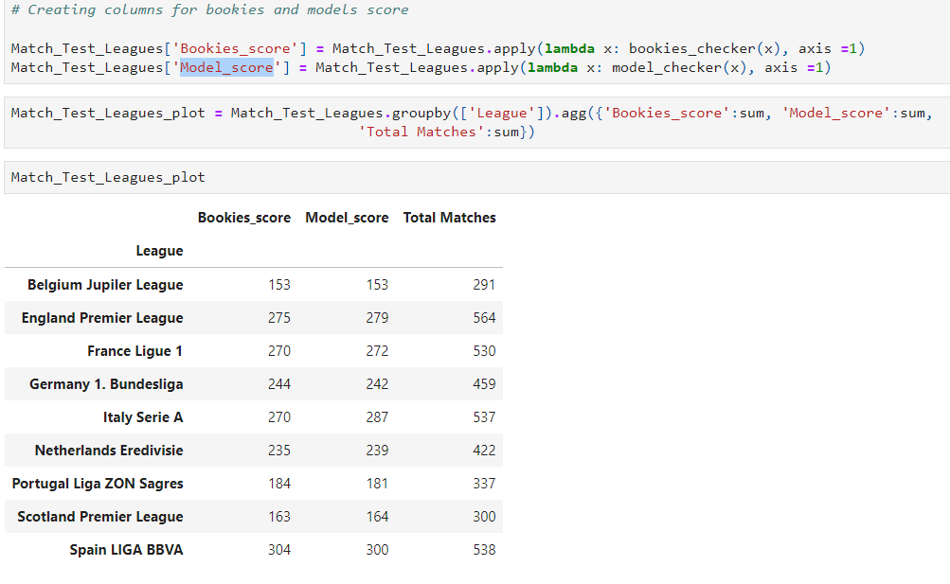
Model Accuracy vs the Bookies Accuracy:
To check our model accuracy, we will compare it with the bookies prediction data which was available in our dataset.
We use our predicted result from the Logistic Regression model and create a function to check whether the model prediction was correct or not.
As per our result, we can see that in most of the cases the Model_score is better than the Bookies_score.

Slide 29
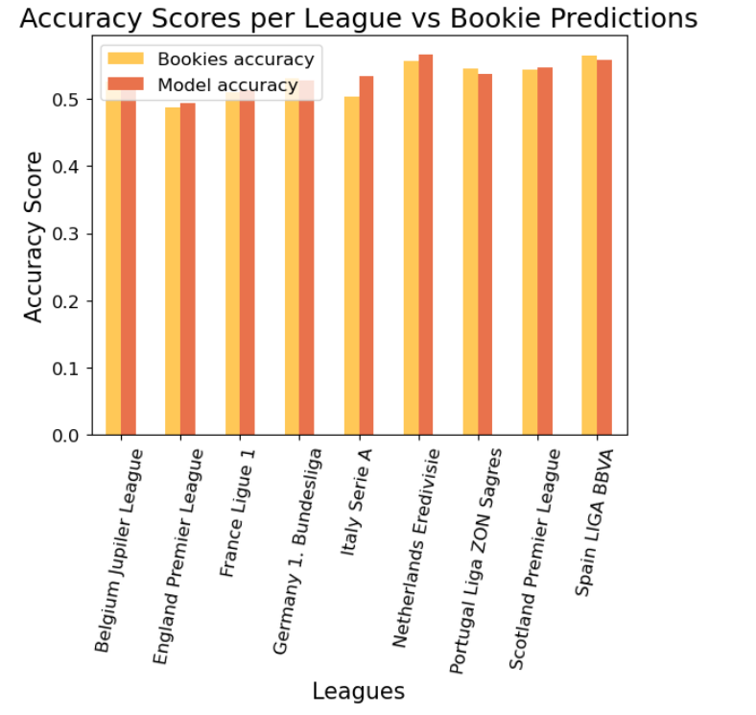
Conclusion
The model with the highest accuracy score on the test match dataset was the Logistic Regression model, followed by Random Forest and K-Nearest Neighbors model.
Linear Regression does not really work with our dataset, as there are only a small number of variations in the dependent variable.
The model accuracy was found to be higher than the bookies accuracy by 47.76 basis points.
Overall, this suggests that the model may be a useful tool for predicting soccer match outcomes more accurately than traditional methods.

Slide 30
Thank You

